Slide 1

Spring 2022
Numpy
multi-dimensional
data arrays
Programming and Data Analysis for Modern Neuroscience
NEU 365P/385L
Marcel Goldschen-ohm
Assistant Professor in the Department of Neuroscience, The University of Texas at Austin

Slide 2
Spring 2022
Numpy
… and why we even consider using python for data science
Programming and Data Analysis for Modern Neuroscience
NEU 365P/385L
Marcel Goldschen-ohm
Assistant Professor in the Department of Neuroscience, The University of Texas at Austin

Slide 3
Learning Objectives
You will appreciate why many types of data are often represented as multi-dimensional arrays.
You will be able to use NumPy to manipulate and get statistics for multi-dimensional arrays.
You will gain some appreciation for why NumPy is an absolute necessity for data science.

Slide 4
Disclaimer
Many of the images are from
https://jalammar.github.io/visual-numpy/

Slide 5
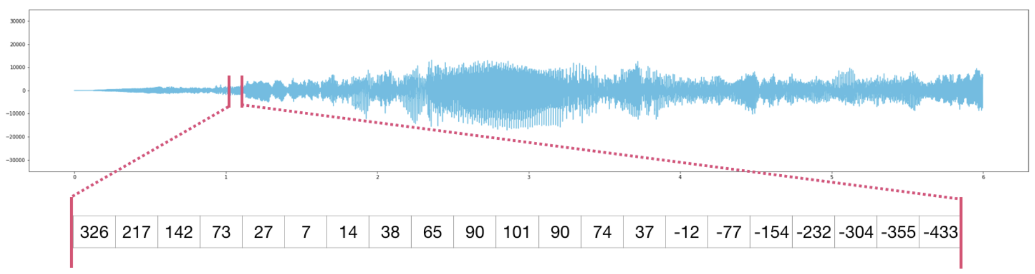
e.g. A time series is a 1D array

Slide 6
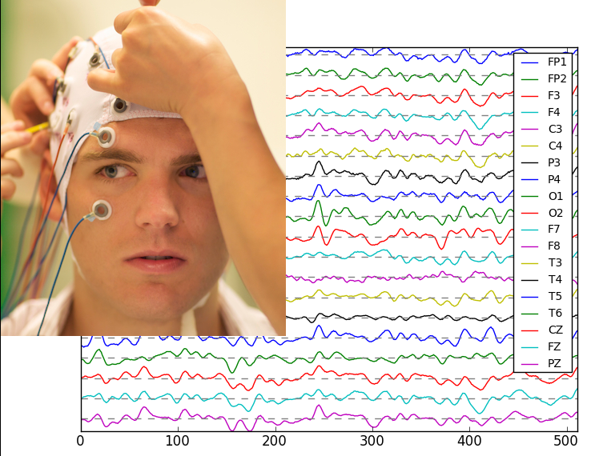
e.g. EEGs from multiple leads is a 2D array

Slide 7
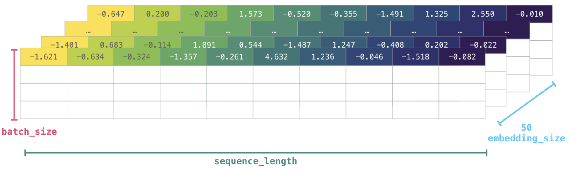
e.g. EEGs from multiple leads is a 2D array
EEG 1
EEG 2
EEG 3
EEG 4

Slide 8
e.g. EEGs from multiple leads across multiple trials is a 3D array
Trial N
Trial 2
Trial 1

Slide 9
e.g. EEGs from multiple leads across multiple trials for multiple subjects is a 4D array
Hard to visualize, but easy to work with mathematically and in code.

Slide 10
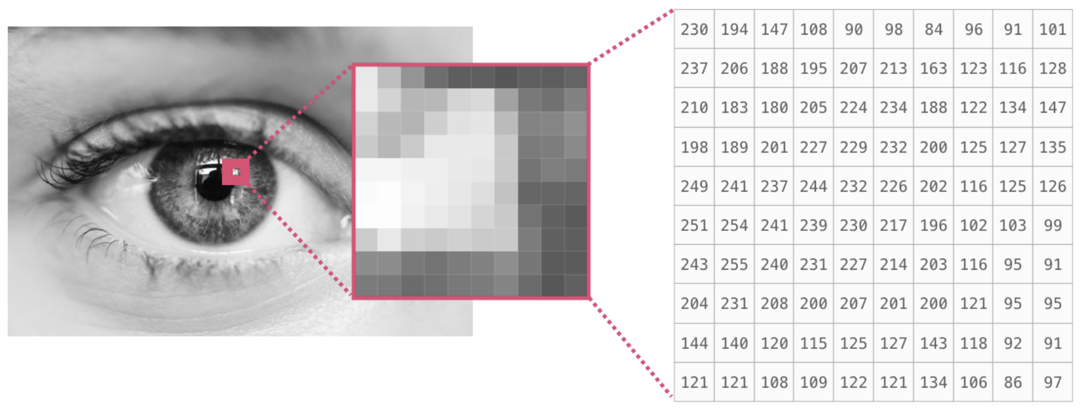
e.g. A grayscale image is a 2D array

Slide 11
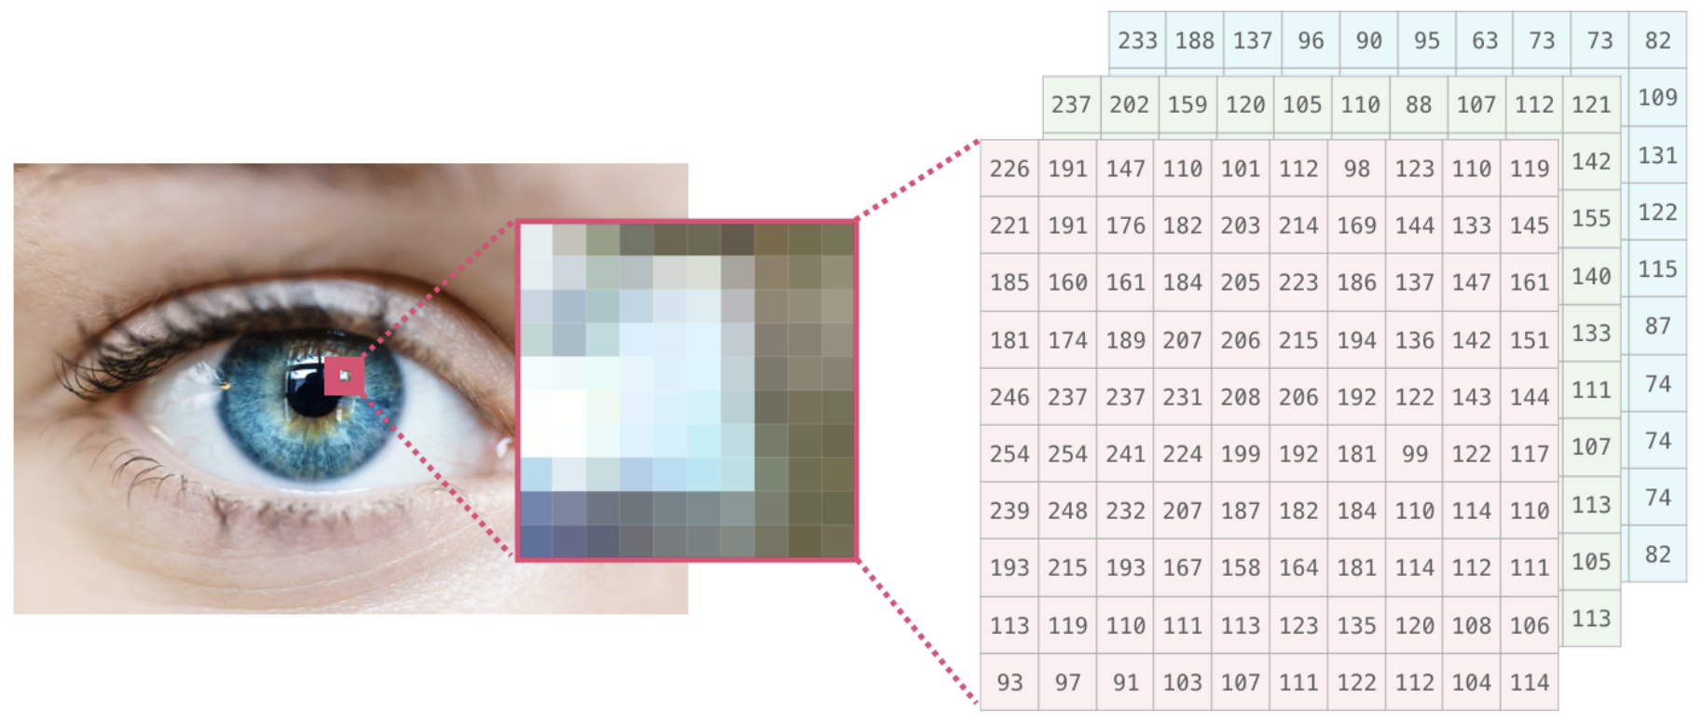
e.g. A color image is a 3D array

Slide 12
e.g. A color movie is a 4D array
Hard to visualize, but easy to work with mathematically and in code.

Slide 13


NumPy
conda install numpy
We’ll answer this as we go
NumPy
Why not just use a list?
import numpy as np
data = [1, 2, 5, 8]
print(data)
data = np.array([1, 2, 5, 8])
print(data)
[1 2 5 8]
[1 2 5 8]

Slide 14
First, a graphical introduction to NumPy before we jump into code…

Slide 15
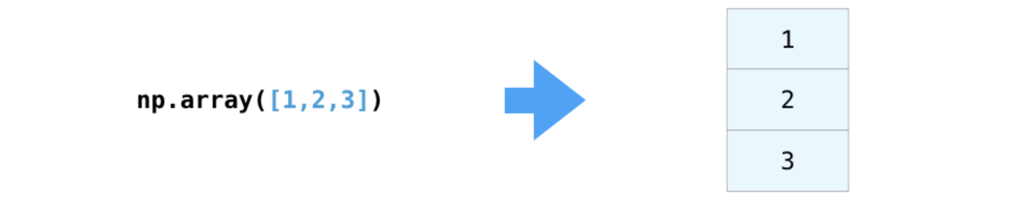
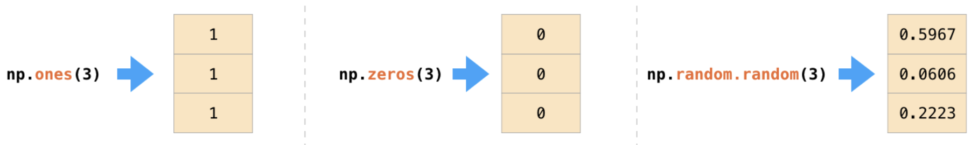
1D array

Slide 16
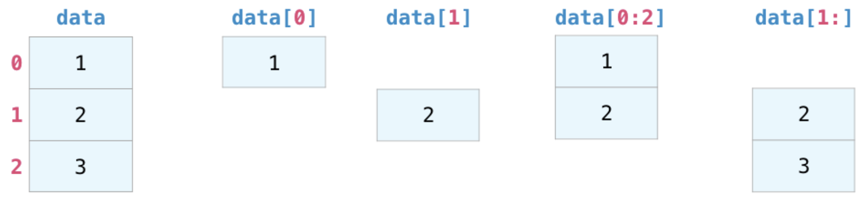
Index and slice a 1D array just like a list

Slide 17
Slicing with logical arrays!
mask = data > 1
data[mask]
False
True
True

Slide 18
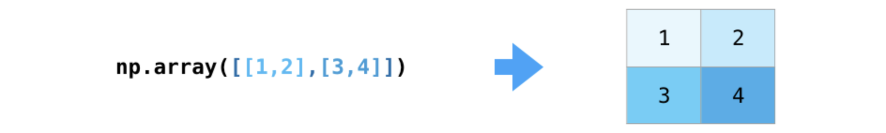
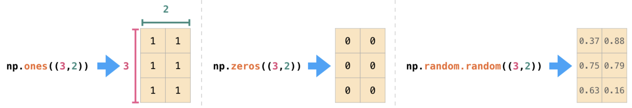
2D array
shape = (3,2)
np.ones(shape)

Slide 19
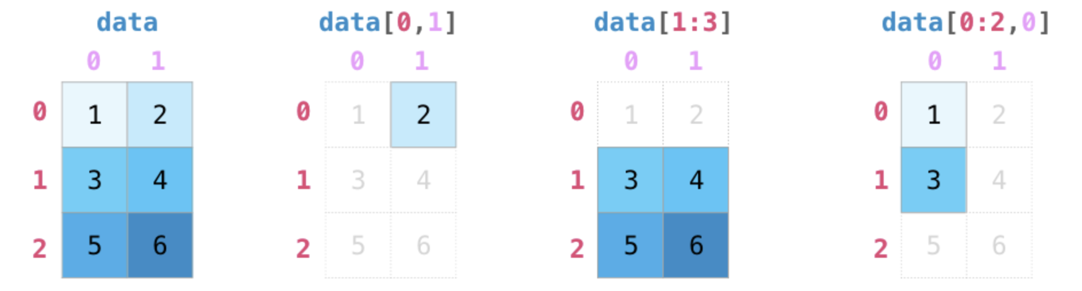
Index and slice a 2D array almost like a list
Impossible with a nested list!

Slide 20
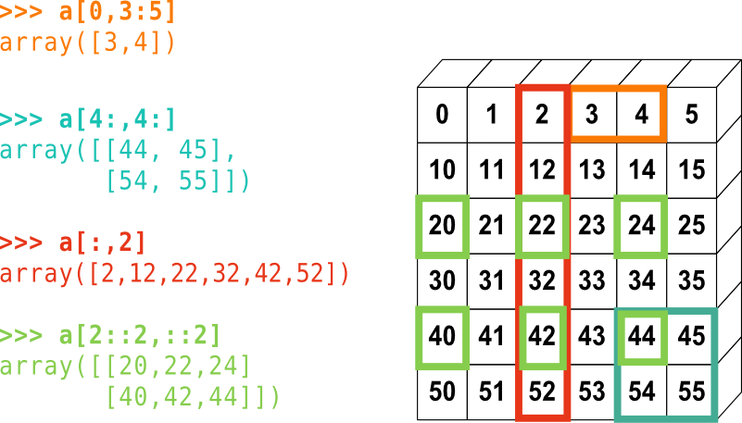
Index and slice a 2D array almost like a list

Slide 21
Numpy slices are references (unlike lists)!
a = data[:2,0]
a[1] = 7
7
7

Slide 22
Copying slices
a = data[:2,0].copy()
a[1] = 7
7

Slide 23
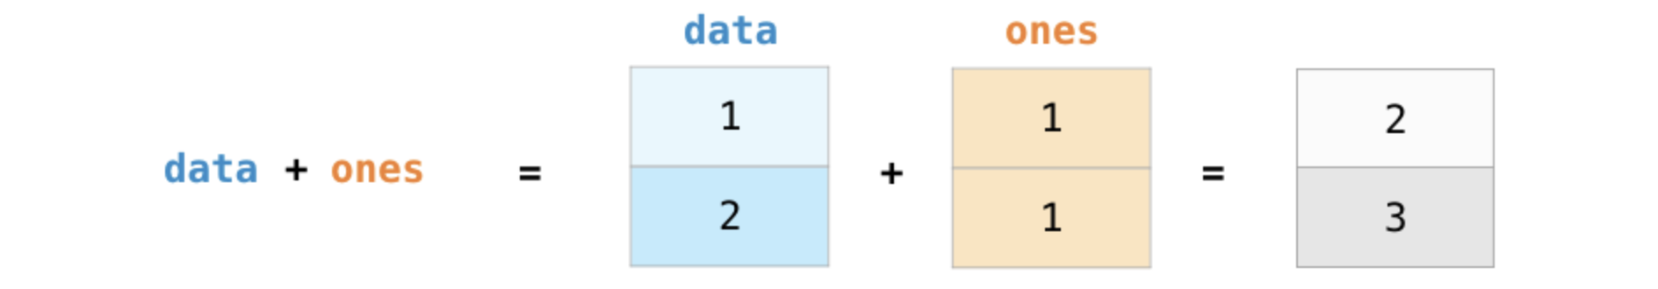
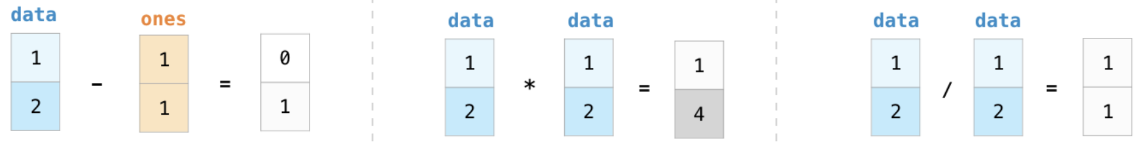
NumPy makes array math easy!

Slide 24
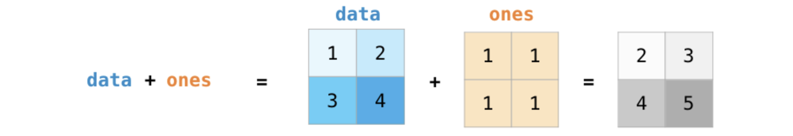
NumPy makes array math easy!

Slide 25
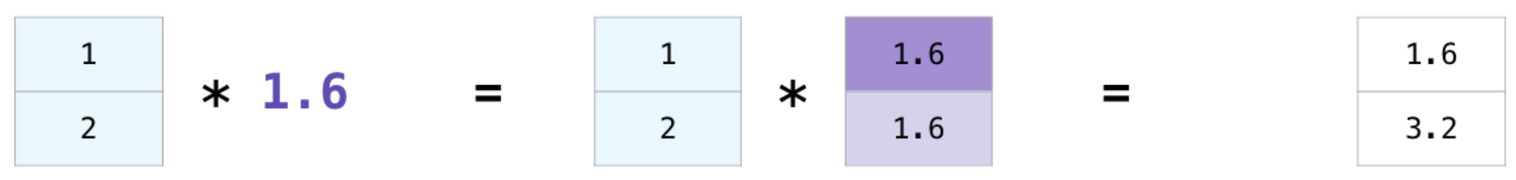
Broadcasting

Slide 26
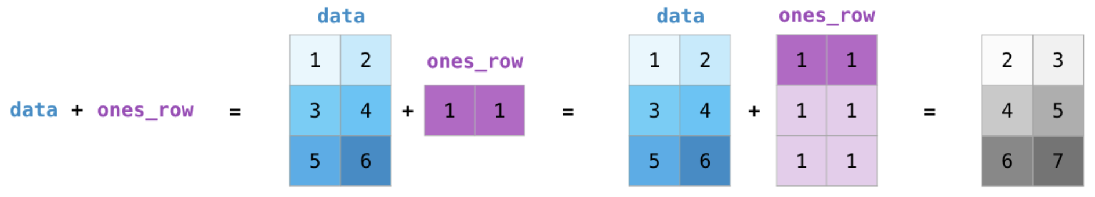
Broadcasting

Slide 27
Broadcasting
!!! This won’t work because there is no way to replicate ones that will match the size of data

Slide 28
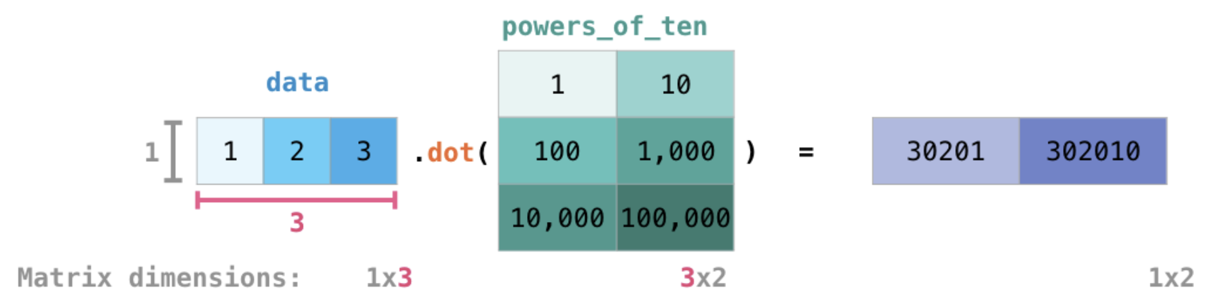
Matrix multiplication
@

Slide 29
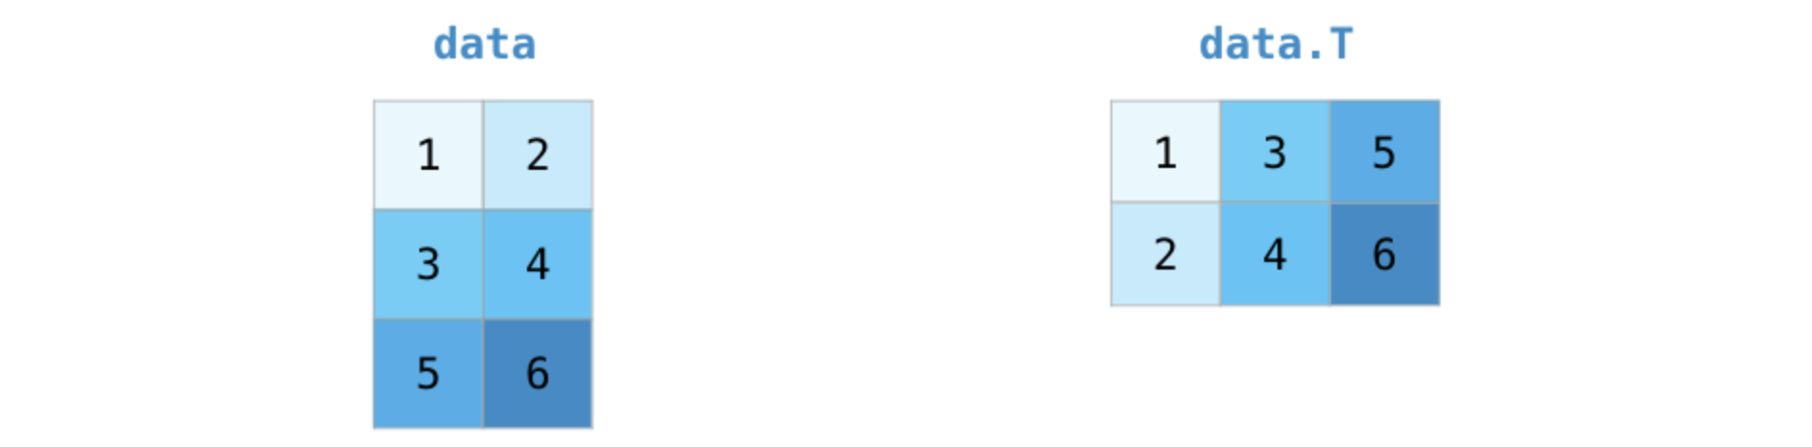
Transpose

Slide 30
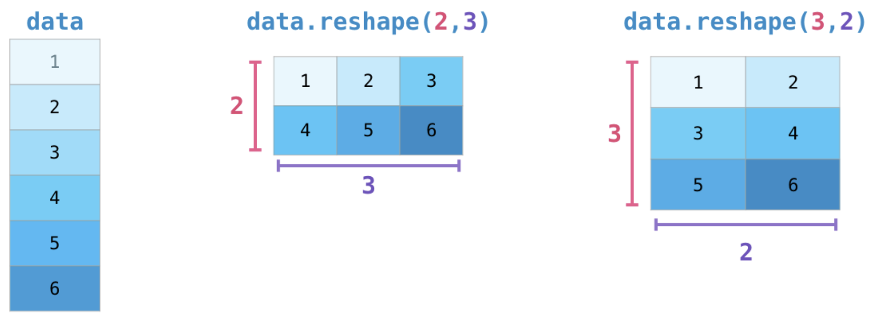
Reshape

Slide 31
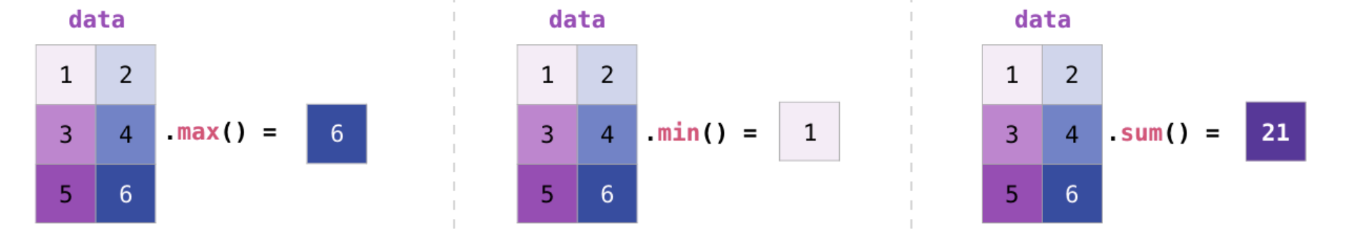
Statistics
and more…
e.g. mean(), var(), std(), …

Slide 32
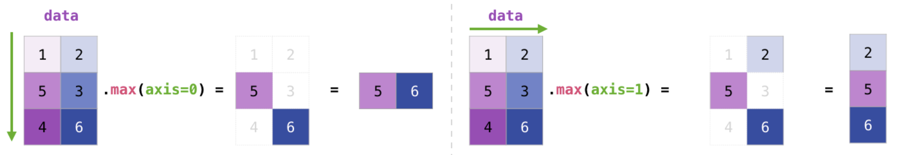
Statistics

Slide 33
Functions: arange, linspace, logspace … and more…
import numpy as np
data = np.arange(2, 11, 2) # start, stop, step
print(data)
[2 4 6 8 10]
data = np.linspace(0, 1, 5) # first, last, number of values
print(data)
[0. 0.25 0.5 0.75 1.]
data = np.logspace(-1, 1, 5) # first power, last power, number of values
print(data)
[0.1 0.316, 1., 3.16, 10.]

Slide 34
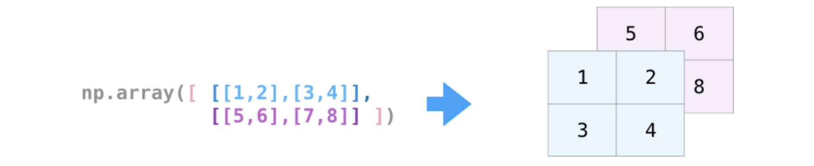
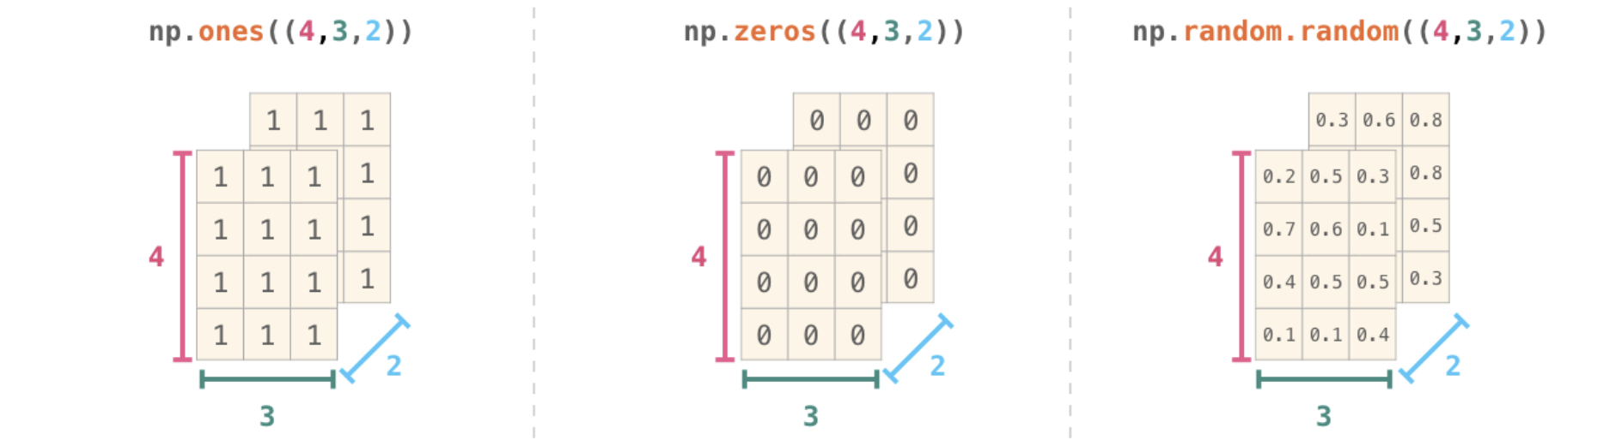
3D array

Slide 35
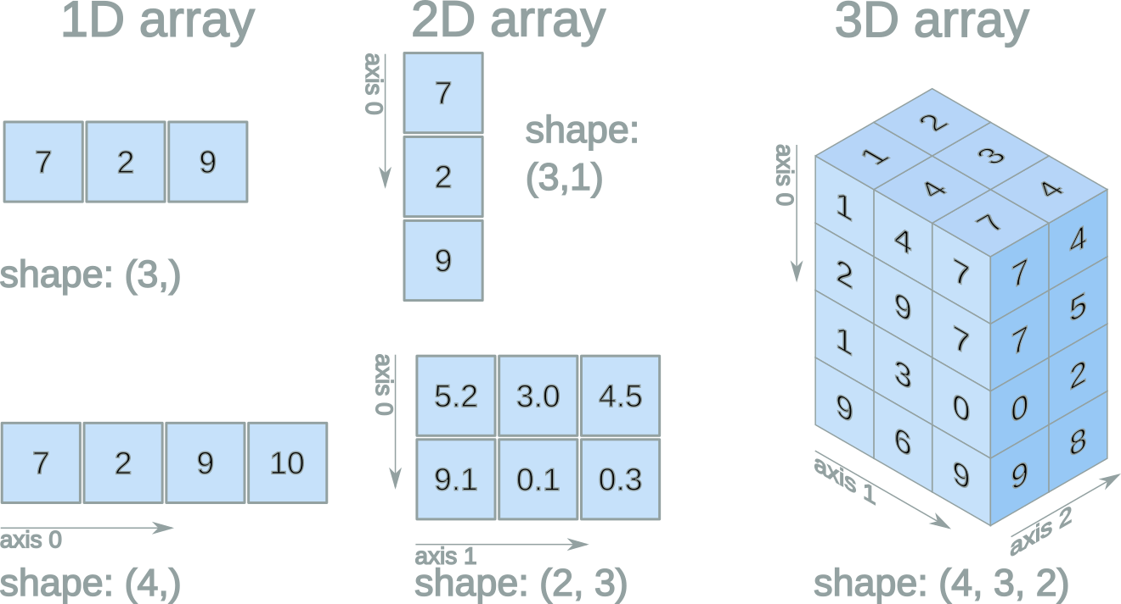
Array shape
# 3D data
data.shape
(4,3,2)
# rows
data.shape[0]
4
# columns
data.shape[1]
3
# depth
data.shape[2]
2

Slide 36
NumPy → perfect for large data arrays
List → great for small collections of disparate items
FAST
SLOW
Easy math
Easy statistics
Limited slicing in nested lists
Multi-dimensional slicing
Can't change array size
Easy to add/remove items
Can hold items of different types
All items must be the same type
Slices are references
Slices are copies

Slide 37
NumPy example with basic plotting
Open numpy-matplotlib-plotly.ipynb in JupyterLab

